Slide 1

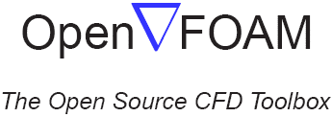
Controlling Fluid Dynamics with Deep
Reinforce Learning
Shouvik Ghorui
OpenFoam Machine Learning Hackathon
Organized by TU Darmstadt
OpenFAOM + ML
1

Slide 2

Contents
Rayleigh–Bénard Convection
Challenges in RBC Control
Active Flow control using DRL
Multi-Agent Reinforcement Learning (MARL)
Optimization in AFC for RBC Control
Add DRL with CFD Environment
Reference
OpenFOAM + ML
2

Slide 3
Why this study is important?
Efficiency Enhancement (efficient heat transfer and fluid dynamics and convective cells control are critical for improving the performance of industrial systems)
Overcoming Traditional Limitations
Optimizing Control Strategies
Introduction
3

Slide 4
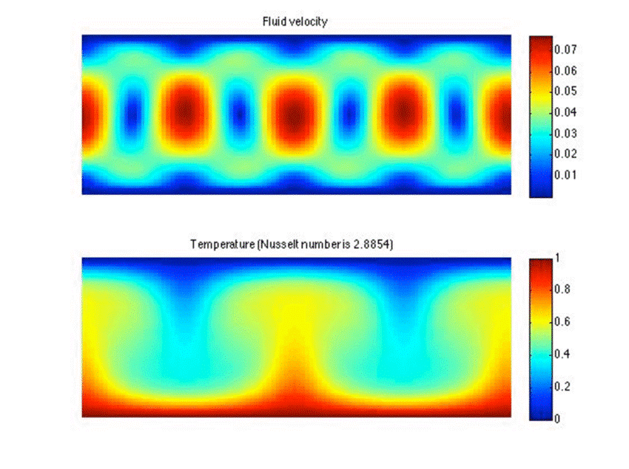
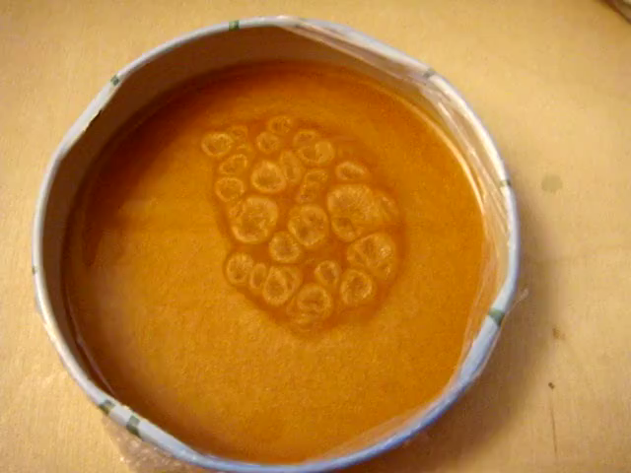
About Rayleigh–Bénard Convection
Natural phenomenon involving the flow of fluids due to temperature differences
Fig: RBC in between two plates and Bénard cells¹
Introduction
4

Slide 5
Challenges in RBC Control
Controlling RBC, including non-linearity, turbulence, and convective cells is challenging.
OF + ML
5

Slide 6
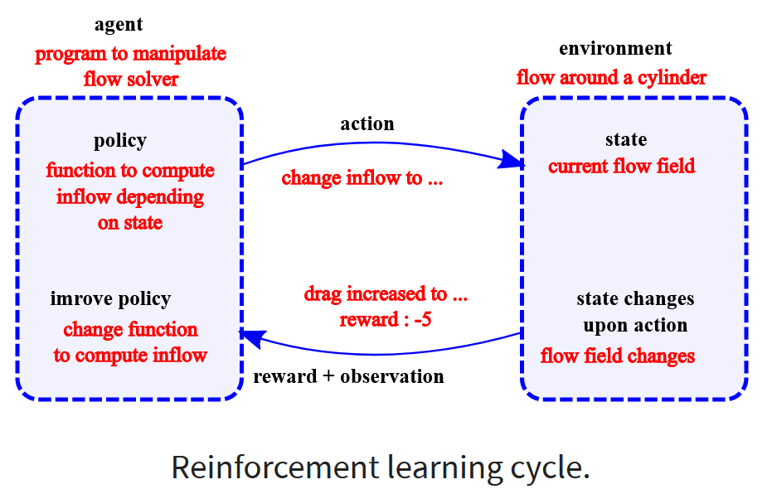
Deep Reinforcement Learning (DRL)
DRL as a subset of machine learning and artificial intelligence.
Basic principles of DRL, including agents, environments, states, actions, and rewards.
OF + ML
6

Slide 7
DRL to Control Flow
Deep Reinforcement Learning (DRL) has emerged as a powerful tool for tackling complex control problems, particularly in the realm of fluid dynamics.
Adaptability to Non-Linearity
Handling High-Dimensional Spaces
OF + ML
7

Slide 8
Optimization in AFC for RBC Control
Parameters to Control (In order to Optimization) :
Temperature gradients or profiles
Flow velocity and direction
Actuator placement and operation
Challenges in Optimization:
High-dimensional control spaces when multiple actuators are involved.
Non-linear and turbulent nature of fluid flows.
Interactions between multiple control parameters.
This challenges can be solved using DLR control, get optimal values using reward mechanism in DRL
OF + ML
8

Slide 9
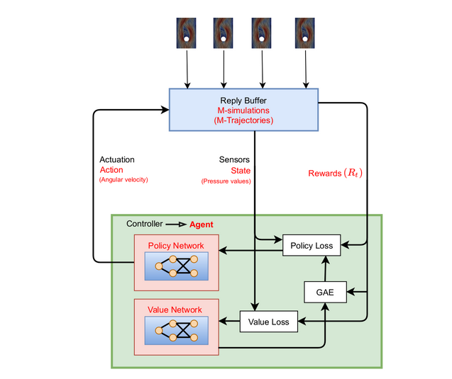
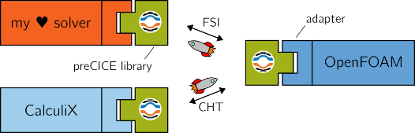
Using OpenFOAM and DRL
CFD(OpenFoam) act as an environment, While NN act as a agent in the Deep Reinforcement learning model
Fig: Deep Reinforcement Learning Architecture ³
OF+ML
9

Slide 10
References
Colin Vignon, Jean Rabault, Joel Vasanth, Francisco Alcántara-Ávila, Mikael Mortensen, Ricardo Vinuesa; Effective control of two-dimensional Rayleigh–Bénard convection: Invariant multi-agent reinforcement learning is all you need. Physics of Fluids 1 June 2023; 35 (6): 065146. https://doi.org/10.1063/5.0153181
https://en.wikipedia.org/wiki/
https://andreweiner.github.io/ml-cfd-slides
References
10

Slide 11
Thank You !
11

